Slide 1
History and Concepts of Drug Courts
Forest County Potawatomi Tribal Court
Paul Stenzel
January 26, 2017
Attorney Paul Stenzel
Forest County Potawatomi Law Day
January 26, 2017

Slide 2
Drug courts are about 25 years old
First drug court was in Miami, FL
At the time in Miami, 70% of arrests were drug related or had a drug component.
Traditional method:
Criminal conduct-→arrest→prosecution→punish→release
REPEAT

Slide 3
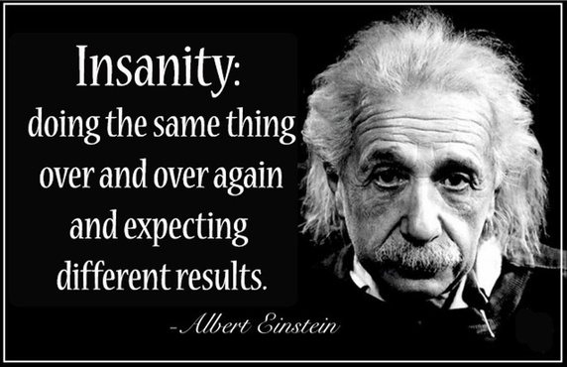

Slide 4
This method wasn’t working.
Recognition of the need to treat the underlying problem: drug addiction.
Incarceration / punitive measures were not treating the underlying problem.

Slide 5
Drug Court: The Beginning:
https://www.youtube.com/watch?v=GDiJj9i4Uws

Slide 6
How drug courts work
For minimum of one year, participants are:
provided with intensive treatment and other services they require to get and stay clean and sober;
held accountable by the Drug Court judge for meeting their obligations to the court, society, themselves and their families;

Slide 7
regularly and randomly tested for drug use;
required to appear in court frequently so that the judge may review their progress; and
rewarded for doing well or sanctioned when they do not live up to their obligations

Slide 8
WHO is eligible?
Eligibility varies by court
Usually, but not always, non-violent offenders
Adult and juveniles
All types of drugs and alcohol
Latest trend is toward high risk/high need.

Slide 9
DRUG COURTS reduce crime
FACT: Nationwide, 75% of Drug Court graduates remain arrest-free at least two years after leaving the program.
FACT: Rigorous studies examining long-term outcomes of individual Drug Courts have found that reductions in crime last at least 3 years and can endure for over 14 years.
FACT: The most rigorous and conservative scientific “meta-analyses” have all concluded that Drug Courts significantly reduce crime as much as 45 percent more than other sentencing options

Slide 10
Drug courts save money
FACT: Nationwide, for every $1.00 invested in Drug Court, taxpayers save as much as $3.36 in avoided criminal justice costs alone.
FACT: When considering other cost offsets such as savings from reduced victimization and healthcare service utilization, studies have shown benefits range up to $27 for every $1 invested

Slide 11
FACT: Drug Courts produce cost savings ranging from $3,000 to $13,000 per client. These cost savings reflect reduced prison costs, reduced revolving-door arrests and trials, and reduced victimization.
FACT: In 2007, for every Federal dollar invested in Drug Court, $9.00 was leveraged in state funding.

Slide 12
Drug courts ensure compliance
FACT: Unless substance abusing/addicted offenders are regularly supervised by a judge and held accountable, 70% drop out of treatment prematurely.
FACT: Drug Courts provide more comprehensive and closer supervision than other community-based supervision programs

Slide 13
Drug courts ensure compliance
FACT: Drug Courts are six times more likely to keep offenders in treatment long enough for them to get better.

Slide 14
Combination of judicial oversight, accountability, treatment and incentives led to tremendous success of drug courts.

Slide 15
This model, called Problem-Solving Courts, went into other areas:
Mental Health Court
Community Court
Domestic Violence Court
Gambling Court
Truancy Court
Gun Court
Homeless Court - - - - - - and many others

Slide 16
10 key components
1. Drug Courts integrate alcohol and other drug treatment services with justice system case processing.

Slide 17
10 key components
2. Using a non adversarial approach, prosecution and defense counsel promote public safety while protecting participants' due process rights.

Slide 18
10 key components
3. Eligible participants are identified early and promptly placed in the drug court program.

Slide 19
10 key components
4. Drug courts provide access to a continuum of alcohol, drug, and other related treatment and rehabilitation services.

Slide 20
10 key components
5. Abstinence is monitored by frequent alcohol and other drug testing.

Slide 21
10 key components
6. A coordinated strategy governs drug court responses to participants’ compliance.

Slide 22
10 key components
7. Ongoing judicial interaction with each drug court participant is essential.

Slide 23
10 key components
8. Monitoring and evaluation measure the achievement of program goals and gauge effectiveness.

Slide 24
10 key components
9. Continuing interdisciplinary education promotes effective drug court planning, implementation, and operations.

Slide 25
10 key components
10. Forging partnerships among drug courts, public agencies, community-based organizations generates local support and enhances drug court effectiveness.

Slide 26
Excerpt from 2015 Parade of Transformation – (If time) – Hopi tribal member (start at 7:40)
https://www.youtube.com/watch?v=192QFow8-nI

